Slide 1




Directives
Angular Basics

Slide 2
Table of Contents
What is a directive and why we need it
How to create directives
Directive specifics for attributes
jQuery plugins directives

Slide 3

What Is a Directive

Slide 4

What Is a Directive
Directives
Extends HTML
Make it easier for "dynamic" pages
Easier to read document
Domain specific tags

Slide 5

What Is a Directive
Main uses of directives
Custom elements (tags)
Custom events
Observe and react to changes

Slide 6
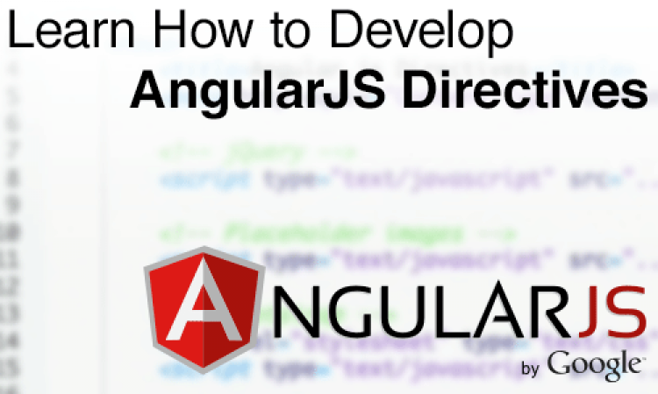
Creating Directives

Slide 7
Creating Directives
Create directives per module
myApp.directive('myDirective', function () {
return {
restrict: 'E', // C, A, M, CA, etc.
template: '<div />' // or templateUrl,
scope: { // isolated scope - &, @, = },
link: function(scope, element, attr) {
// put logic here, },
compile: function(element, attr) { // compile },
replace: true, priority: 0
};
});

Slide 8

Directive Attribute Specifics

Slide 9
Attribute Specifics
Manipulating attribute
link: function (scope, element, attrs) {
console.log(attrs.ngModel);
attrs.$set('ngModel', 'new value');
// observe changes to interpolated attribute
attrs.$observe('ngModel', function(newVal, oldVal) {
console.log('ngModel has changed to ' + value);
});
}

Slide 10

jQuery Plugins Directives

Slide 11
jQuery as Directive
jQuery plugin directives
<input type="text" date-picker />
myApp.directive('datePicker', function () {
return {
restrict: 'A',
link: function(scope, element, attr) {
element.datepicker();
},
};
});

Slide 12
Summary
What are directives
Create directives
Specifics

Slide 13
AngularJS
http://academy.telerik.com

Slide 14
Exercises
Create AngularJS SPA client for the Tic-Tac-Toe Web API project used in the "Web Services and Cloud" course in lecture "Web API Architecture"
Use routing – for every single page
Use controllers – games, users, playing, etc.
Use services – restful usage, game logic, etc.
Use filters – for visualization of the bindings
Use directives – for domain specific parts of the HTML

